Slide 1

4
The future of apps
xamarin1301
4
The future of apps
Dave Evans
dave@pml.co.uk
@DaveDev

Slide 2
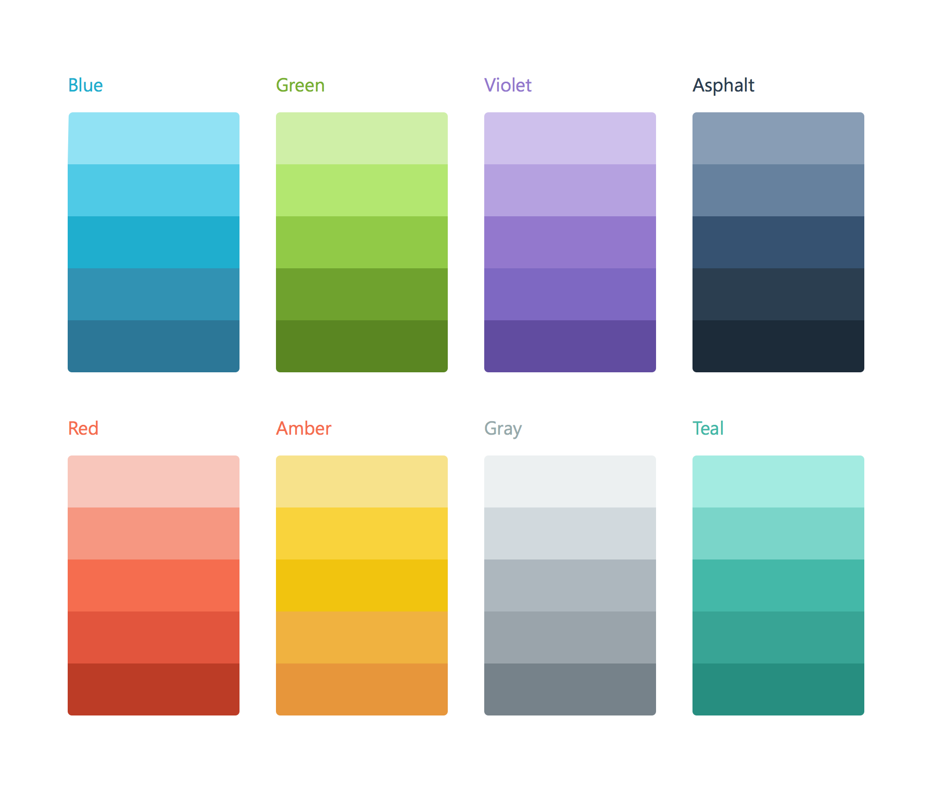
Xamarin’s Mission
Make it fast, easy, and fun to create great mobile apps.

Slide 3




Your priorities when building apps
Native
5-Star App
Works Everywhere
Integration
Stay current

Slide 4


Xamarin 4
Enterprise-grade
Complete
mobile lifecycle

Slide 5




Xamarin – Your Complete Mobile Solution
BUILD
TEST
MONITOR
ACCELERATE
Notes:
Xamarin is your complete mobile solution.
Xamarin Platform is usually what you hear about which is building native iOS, Android, Mac, and Windows Apps all in C#
However Xamarin offers a wide range of products for developers to go mobile including Test Cloud, Insights, and a way to learn all of mobile with University.

Slide 6



Xamarin 4: the complete mobile lifecycle
BUILD
TEST
MONITOR
ACCELERATE
Notes:
Xamarin is your complete mobile solution.
Xamarin Platform is usually what you hear about which is building native iOS, Android, Mac, and Windows Apps all in C#
However Xamarin offers a wide range of products for developers to go mobile including Test Cloud, Insights, and a way to learn all of mobile with University.

Slide 7
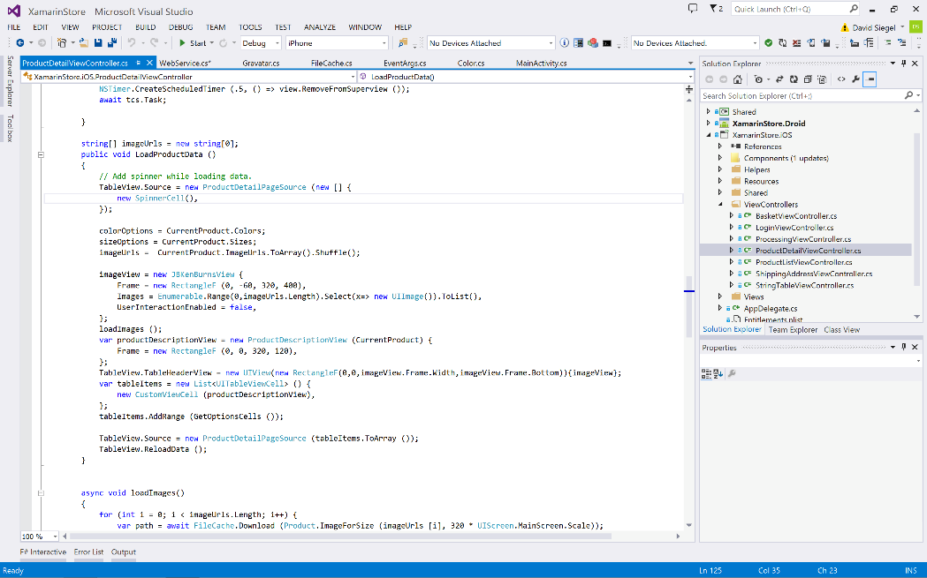
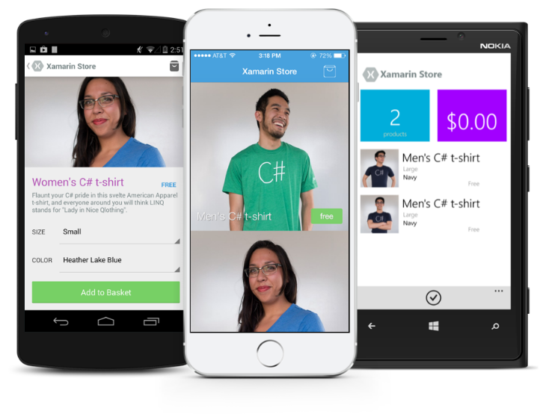
Xamarin Platform: native apps across platforms

Slide 8
Xamarin’s Unique Approach
iOS C# UI
Android C# UI
Windows C# UI
Shared C# (or F#) Mobile
Shared C# codebase • 100% native API access • High performance
Notes:
UI build natively per platform, leveraging C#
C# + XAML
C# + XML
C# + XIB
One shared app logic code base, iOS, Android, Mac, Windows Phone, Windows Store, Windows

Slide 9
Xamarin + Xamarin.Forms
iOS C# UI
Android C# UI
Windows C# UI
Shared UI Code
Shared C# Code
Shared C# Code
Traditional Xamarin Approach
With Xamarin.Forms: More code-sharing, all native
Notes:
Xamarin recently introduced Xamarin.Forms a new library for cross platform user interface. We will touch up on this later, but this enables you to be highly productive, share code, but build out UI on each platform and access platform APIs.
With Xamarin.Forms you now have a nice Shared UI Code layer, but still access to platform APIs
You can start from native, pick a few screens, or start with forms, and replace with native later

Slide 10

Windows APIs
Microsoft.Phone
Microsoft.Networking
Windows.Storage
Windows.Foundation
Microsoft.Devices
System.Net
System
System.IO
System.Linq
System.Xml
System.Data
System.Windows
System.Numerics
System.Core
System.ServiceModel
Notes:
If you have ever developed for a Windows Platform before these .NET namespaces might look familiar.
However, if we go to a new platform such as Windows Phone or Store we have a new SDK to use and a new set of namespaces.

Slide 11
iOS – 100% API Coverage
MapKit
UIKit
iBeacon
CoreGraphics
CoreMotion
System.Net
System
System.IO
System.Linq
System.Xml
System.Data
System.Windows
System.Numerics
System.Core
System.ServiceModel
Notes:
You can think of iOS and Android development the same with Xamarin. You can see we have all of our .NET namespaces and libraries, but Xamarin give us 100% api coverage of each iOS API in it’s SDK that we access view C#.

Slide 12
Android – 100% API Coverage
Text-to-speech
ActionBar
Printing Framework
Renderscript
NFC
System.Net
System
System.IO
System.Linq
System.Xml
System.Data
System.Windows
System.Numerics
System.Core
System.ServiceModel
Notes:
The same is true for Android as well.

Slide 13
Anything you can do in Objective-C, Swift, or Java can be done in C# and Visual Studio with Xamarin.

Slide 14
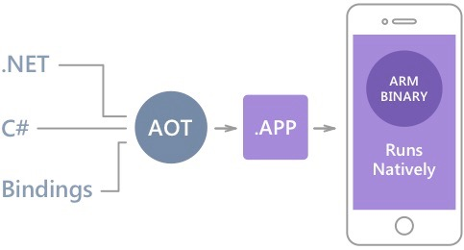
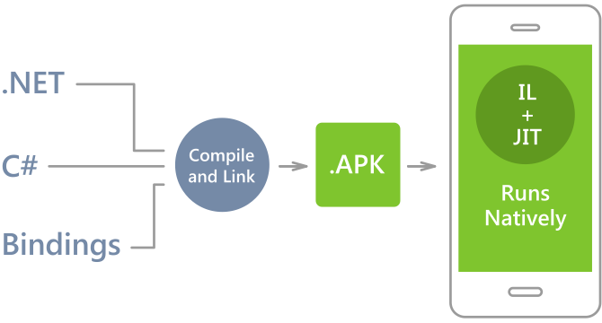
Native Performance
Xamarin.iOS does full Ahead Of Time (AOT) compilation to produce an ARM binary for Apple’s App Store.
Xamarin.Android takes advantage of Just In Time (JIT) compilation on the Android device.
Notes:
There is no compromise on performance.
Xamarin apps look and feel native because they are native.

Slide 15
✓Always Up-to-Date
Same-day support:
iOS 5
iOS 6
iOS 7
iOS 7.1
iOS 8
iOS 9
Full support for:
Apple Watch
Google Glass
Android Wear
Amazon Fire TV
and much more
Notes:
Apple has a developer preview where Xamarin has alphas ready. Google does not offer this.
Android versions are usually 4 to 8 weeks out for a stable release, but alphas and betas are usually earlier.
Xamarin realizes how important having iOS ready because within 24 hours a large portion of iOS users upgrade
Android on the other hand is much different. After 4 months on the market Android 4.4 only had 1% adoption

Slide 16
Code Sharing Stats
iCircuit
Touch Draw
Android
iOS
Mac
Windows Phone
Notes:
iCircuit is made by Frank Krueger, a long time Mono & Xamarin developer.
Sharing code lead to 70 to 90% code reuse across platforms speeding up development
Real-time circuit simulator and editor used to design analog and digital circuits
http://praeclarum.org/post/42378027611/icircuit-code-reuse-part-cinq

Slide 17


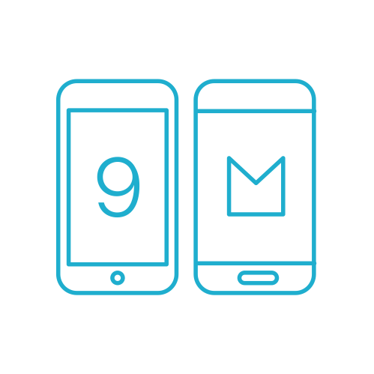

What’s new in Xamarin Platform?
Enhanced VS Integration
Xamarin.Forms 2.0
iOS 9 & Android M
Preview
Technologies

Slide 18
Visual Studio Integration Enhancements
Seamless Integration & Setup
Resilient Build Connection
Enhanced iOS & Android Designers
Notes:
Built from the ground up over a secure SSH connection
Build and Connect from multiple instances of Visual Studio
Designers: XIB and Material Design Support & Updates

Slide 19
Xamarin.Forms 2.0
Deep Integrations with iOS 9 and Android Marshmallow
Material Design (AppCompat)
Performance Optimisations
Pre-compiled XAML
Windows 10 (UWP) Preview
New Gestures
Notes:
AppCompat delivers visual beautify across all version of Android
ListView overhaul with amazing optimizations for images and cell recycling
Support for iOS, Android, Windows Phone 8, Win RT Phone/Store 8.1, and Windows 10 UWP
Pull to refresh & Pinch gestures & more to come!

Slide 20
Demo

Slide 21



Preview Technologies
Objective Sharpie
CocoaPod Integration
Profiler
Inspector

Slide 22
Demo

Slide 23

Xamarin – Your Complete Mobile Solution
BUILD
TEST
MONITOR
ACCELERATE
Notes:
Xamarin is your complete mobile solution.
Xamarin Platform is usually what you hear about which is building native iOS, Android, Mac, and Windows Apps all in C#
However Xamarin offers a wide range of products for developers to go mobile including Test Cloud, Insights, and a way to learn all of mobile with University.

Slide 24
Device Fragmentation
App Complexity
Fast Release Cycles
Short Sessions
High Mobile User Expectations
Challenges
Notes:
Well there are several challenges that we must overcome as mobile developers including….

Slide 25
On Mobile, Quality is Hard
7
20
20
35
6
OS versions
Devices
Languages
Locales
Screen sizes
10
24K+
39
57
27
15
6
OS versions
Distinct devices
Languages
Locales
Screen sizes
Manufacturers
Screen configurations
8
Notes:
First let’s take a look at the shear number of configurations there are between iOS and Android. As iOS progresses this number is only set to increase, and on Android it is already a HUGE number of configurations to even think about testing.
iOS: 7, 7.1, 8, 8.1, 8.2, and iOS 9, iOS 9.1

Slide 26
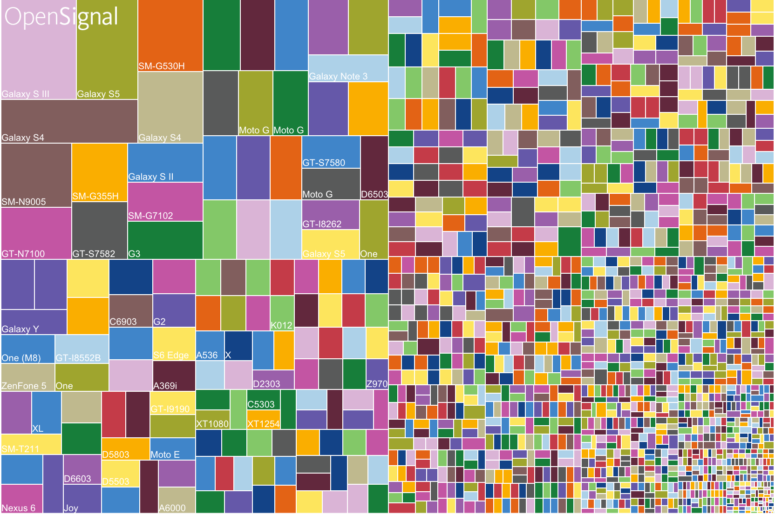
Android diversification

Slide 27
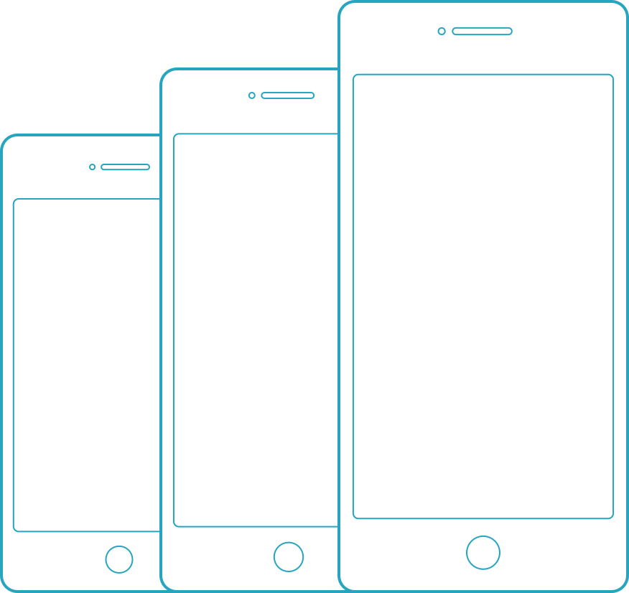
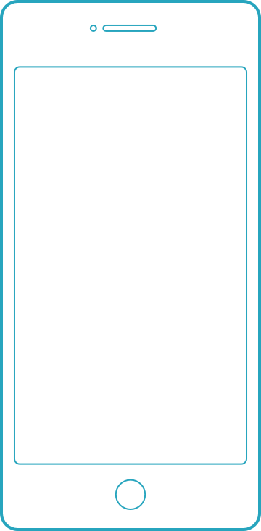
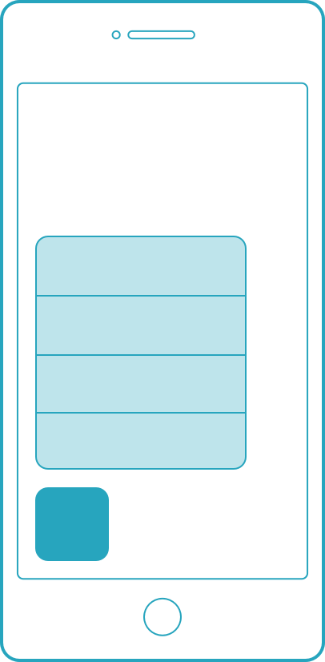
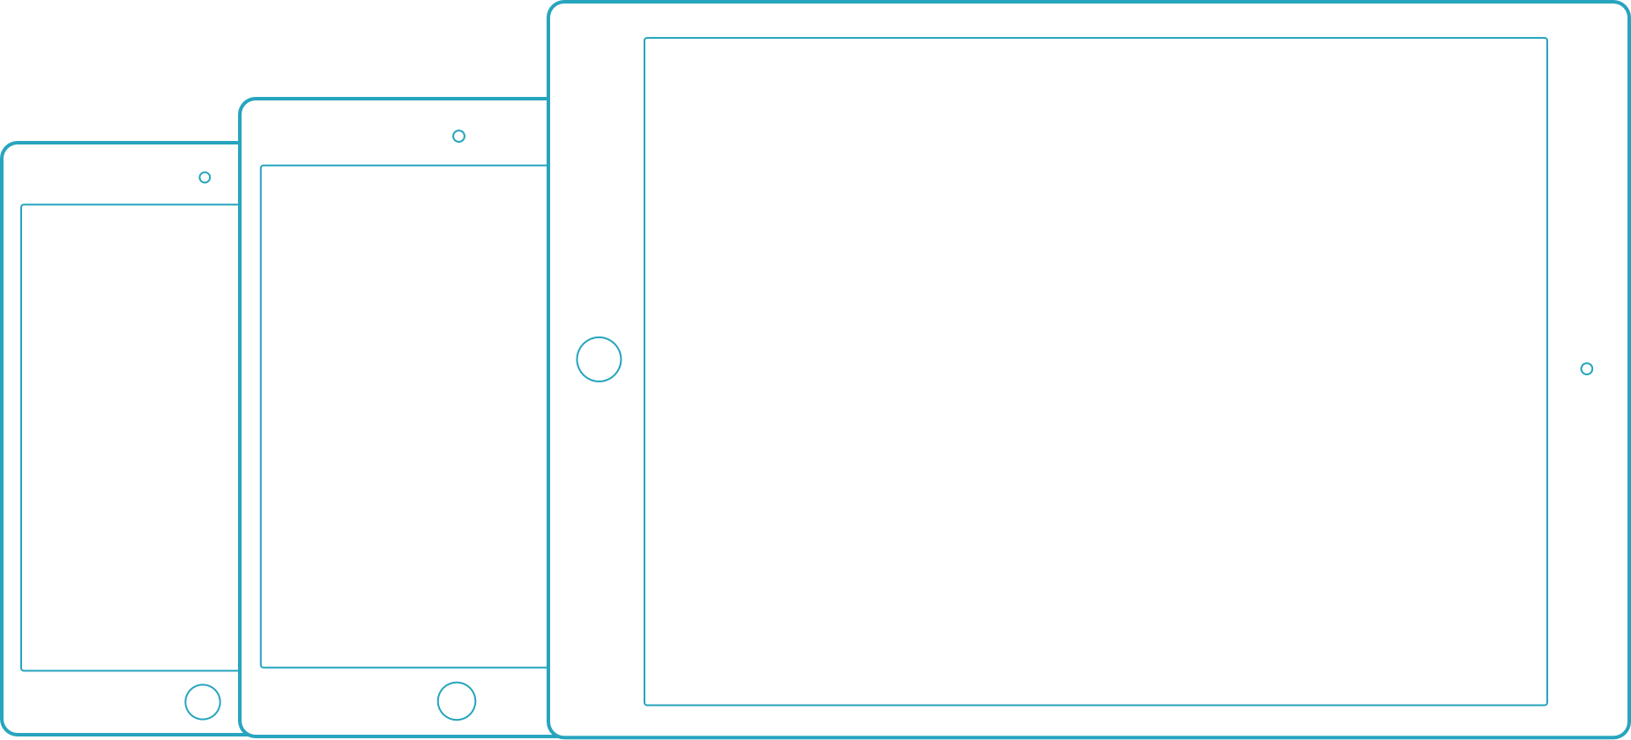
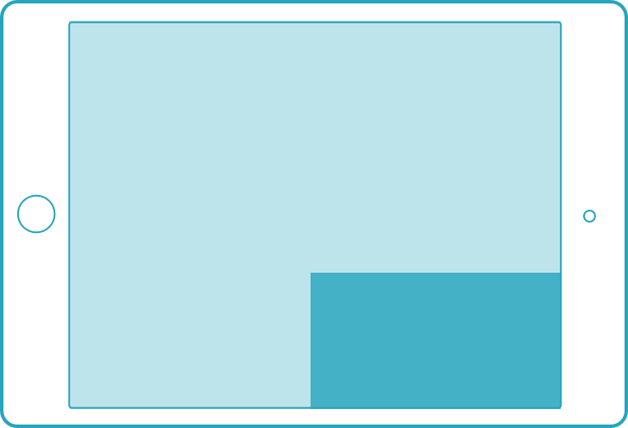
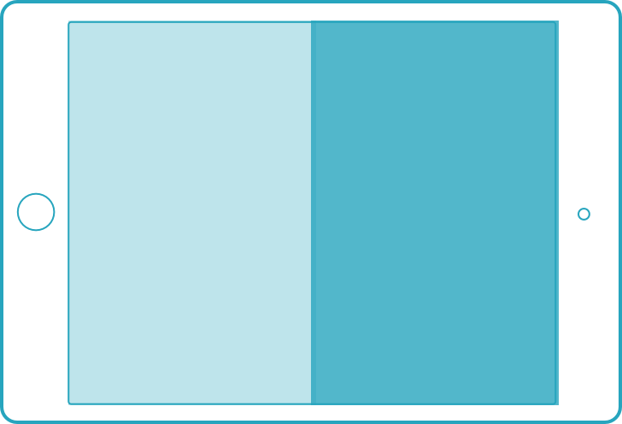
iOS diversification
3D Touch
Apple pencil
iPhones
iPod touch
iPad Pro only
iPhone 6s series only
iPads
Multi Tasking
Only select iPads
Form factors
iOS 9 features

Slide 28
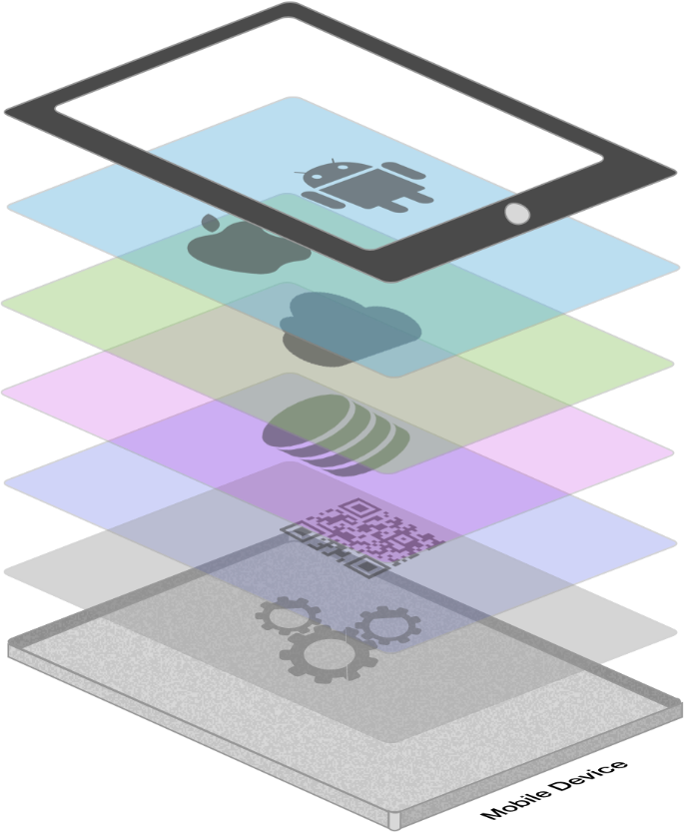






App Complexity
Thousands of iOS and Android APIs
Public web APIs
Backend integrations
Third party libraries
Memory, CPU and network constraints
Notes:
The fragmentation isn’t just in the devices, but as we start to build on our applications you soon found out they are ever increasingly complex.

Slide 29








Tap
Scroll
Swipe
Pinch
Multi Finger
Text Entry
Rotation
GPS
Notes:
With a simple command you can simulate all of your users interactions to build out a great test suite that can be run over and over again.

Slide 30
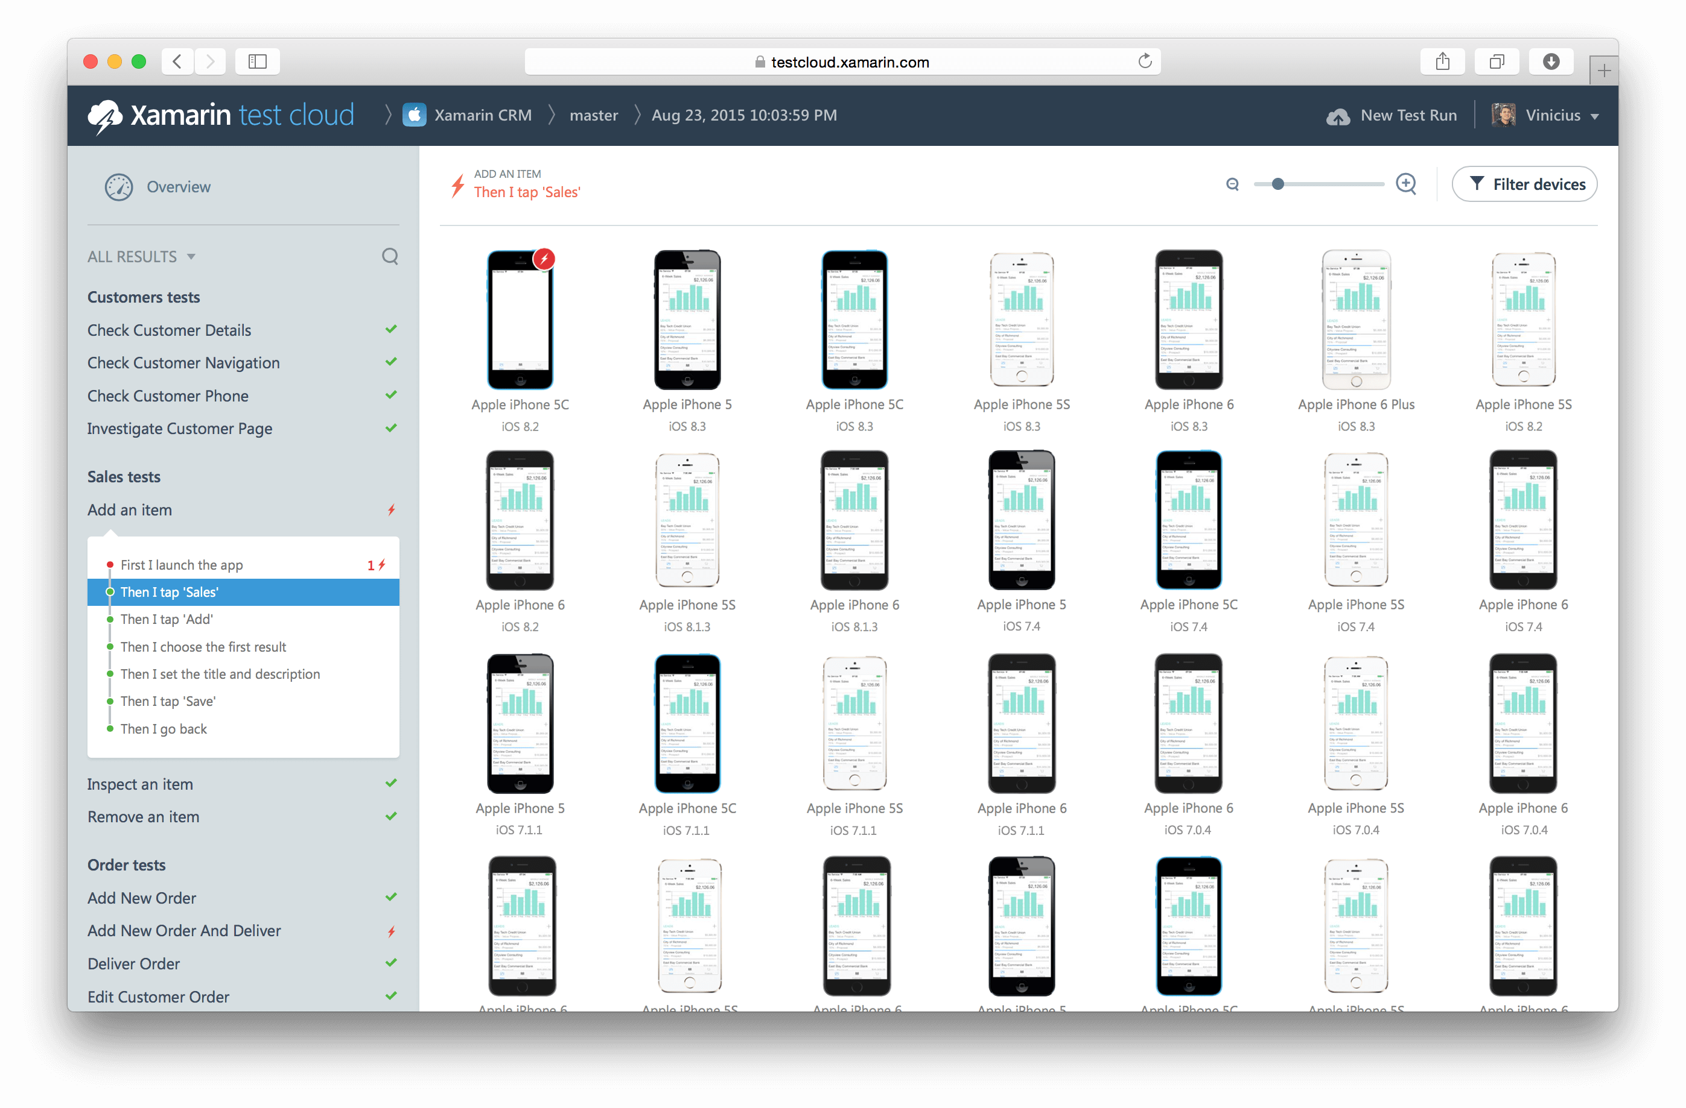
Xamarin Test Cloud: automated testing on thousands of devices

Slide 31
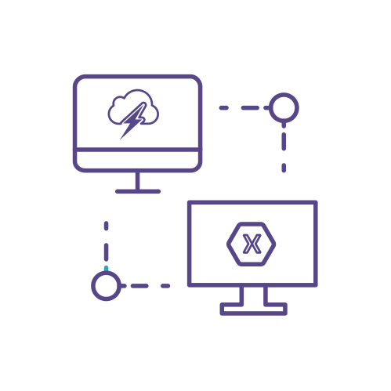


What’s new in Xamarin Test Cloud?
Integrated with Platform
UITest 1.0
Test Recorder
Notes:
Integrated:
-New app templates & easily upload to Test Cloud
UITest 1.0
-Unlimited test runs for free on simulator or local device!
Test Recorder
-Easily create tests with a tap of your app
-Copy out test or upload to test cloud

Slide 32
Demo
http://bit.ly/testcloud-offer with the code Xamarin4

Slide 33
Xamarin – Your Complete Mobile Solution
BUILD
TEST
MONITOR
ACCELERATE
Notes:
Xamarin is your complete mobile solution.
Xamarin Platform is usually what you hear about which is building native iOS, Android, Mac, and Windows Apps all in C#
However Xamarin offers a wide range of products for developers to go mobile including Test Cloud, Insights, and a way to learn all of mobile with University.

Slide 34
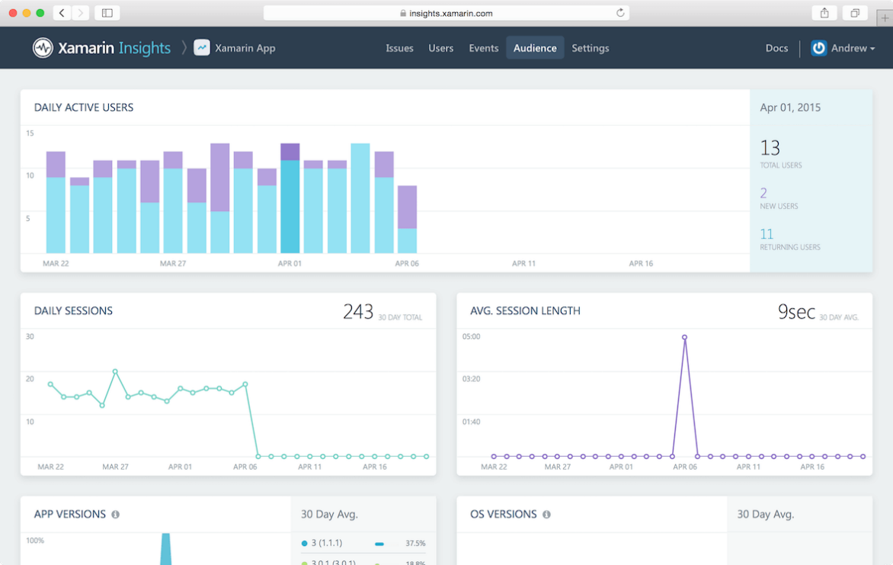
Xamarin Insights – Real-time monitoring
Supports
✓ Xamarin.iOS
✓ Xamarin.Android
✓ Xamarin.Mac
✓ Windows Phone
✓ Windows Store
✓ Windows Desktop
Notes:
Xamarin.Insights, currently in preview, enables us to support all of our apps from a full cross platform API.

Slide 35
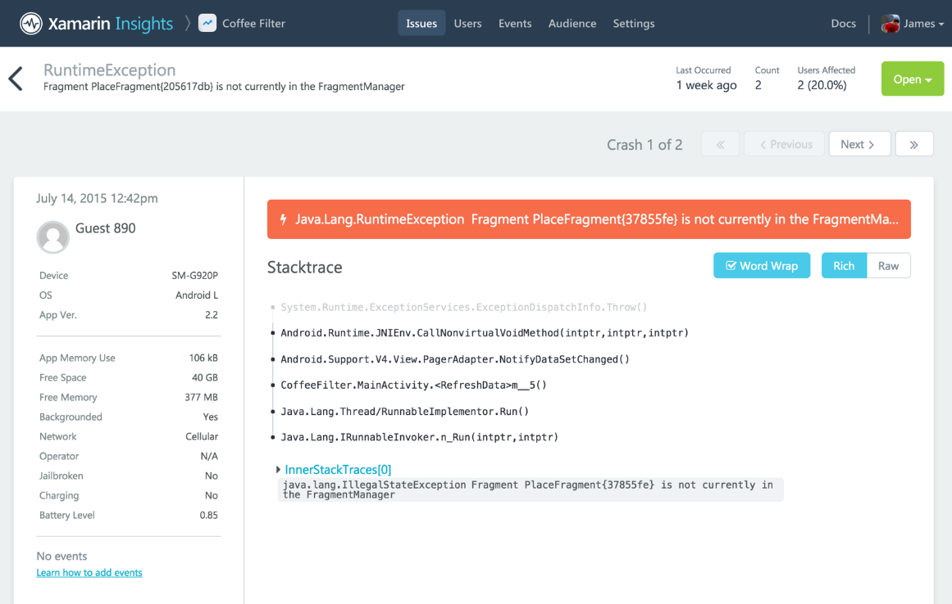
Xamarin Insights – Report
Automatically report any uncaught managed or native exception.
Report your own caught exceptions with simple cross-platform API.

Slide 36
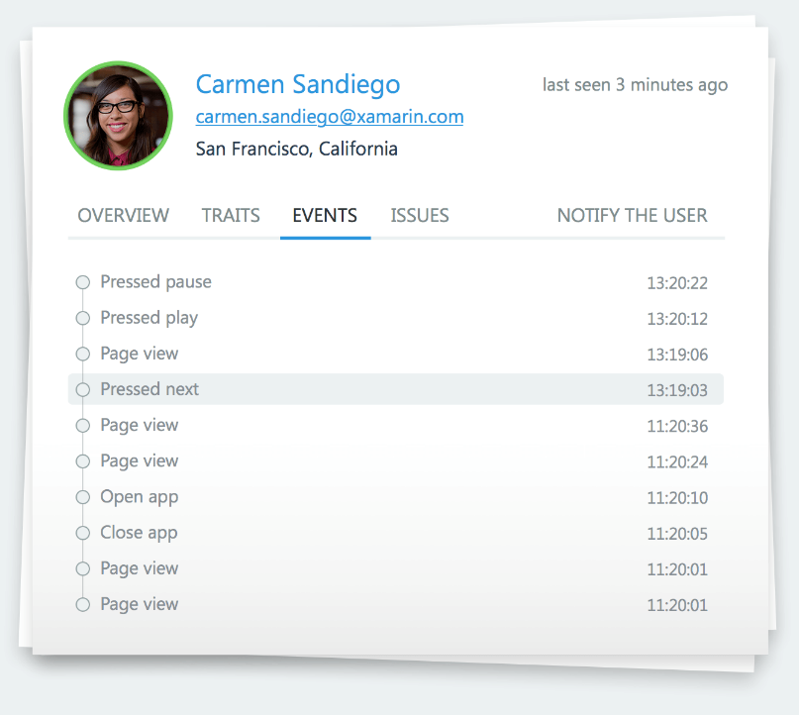
Xamarin Insights – Track
Track any event that occurs in your application.
Even track performance of how long an operation takes.

Slide 37
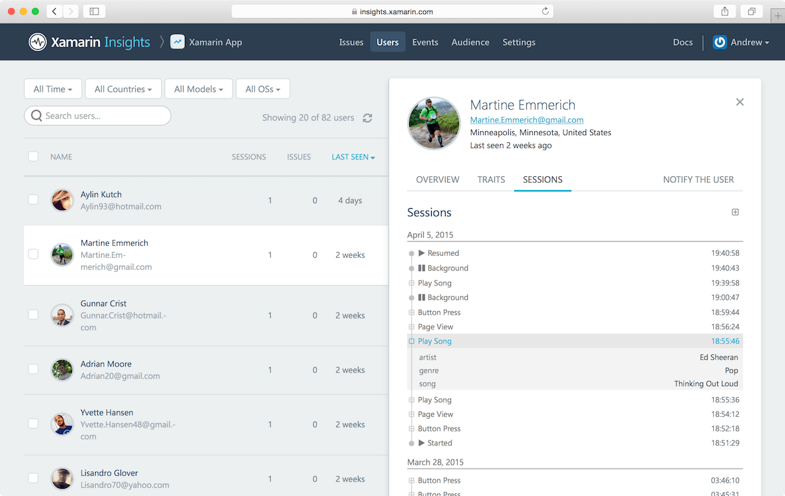
Xamarin Insights – Identify
Combine event tracking with user identification to resolve issues faster.

Slide 38





Xamarin Insights – Integrate
Simple integrations into popular services
for mission critical notifications.
Notes:
Xamarin.Insights, currently in preview, enables us to support all of our apps from a full cross platform API.

Slide 39
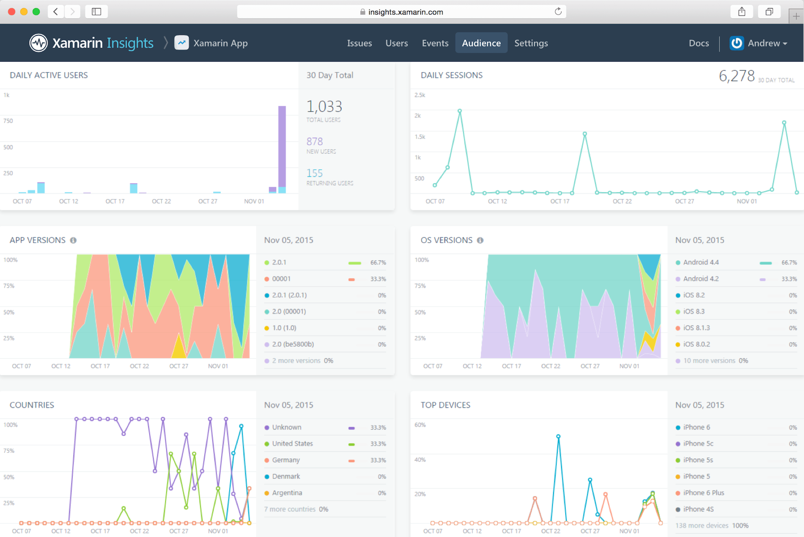
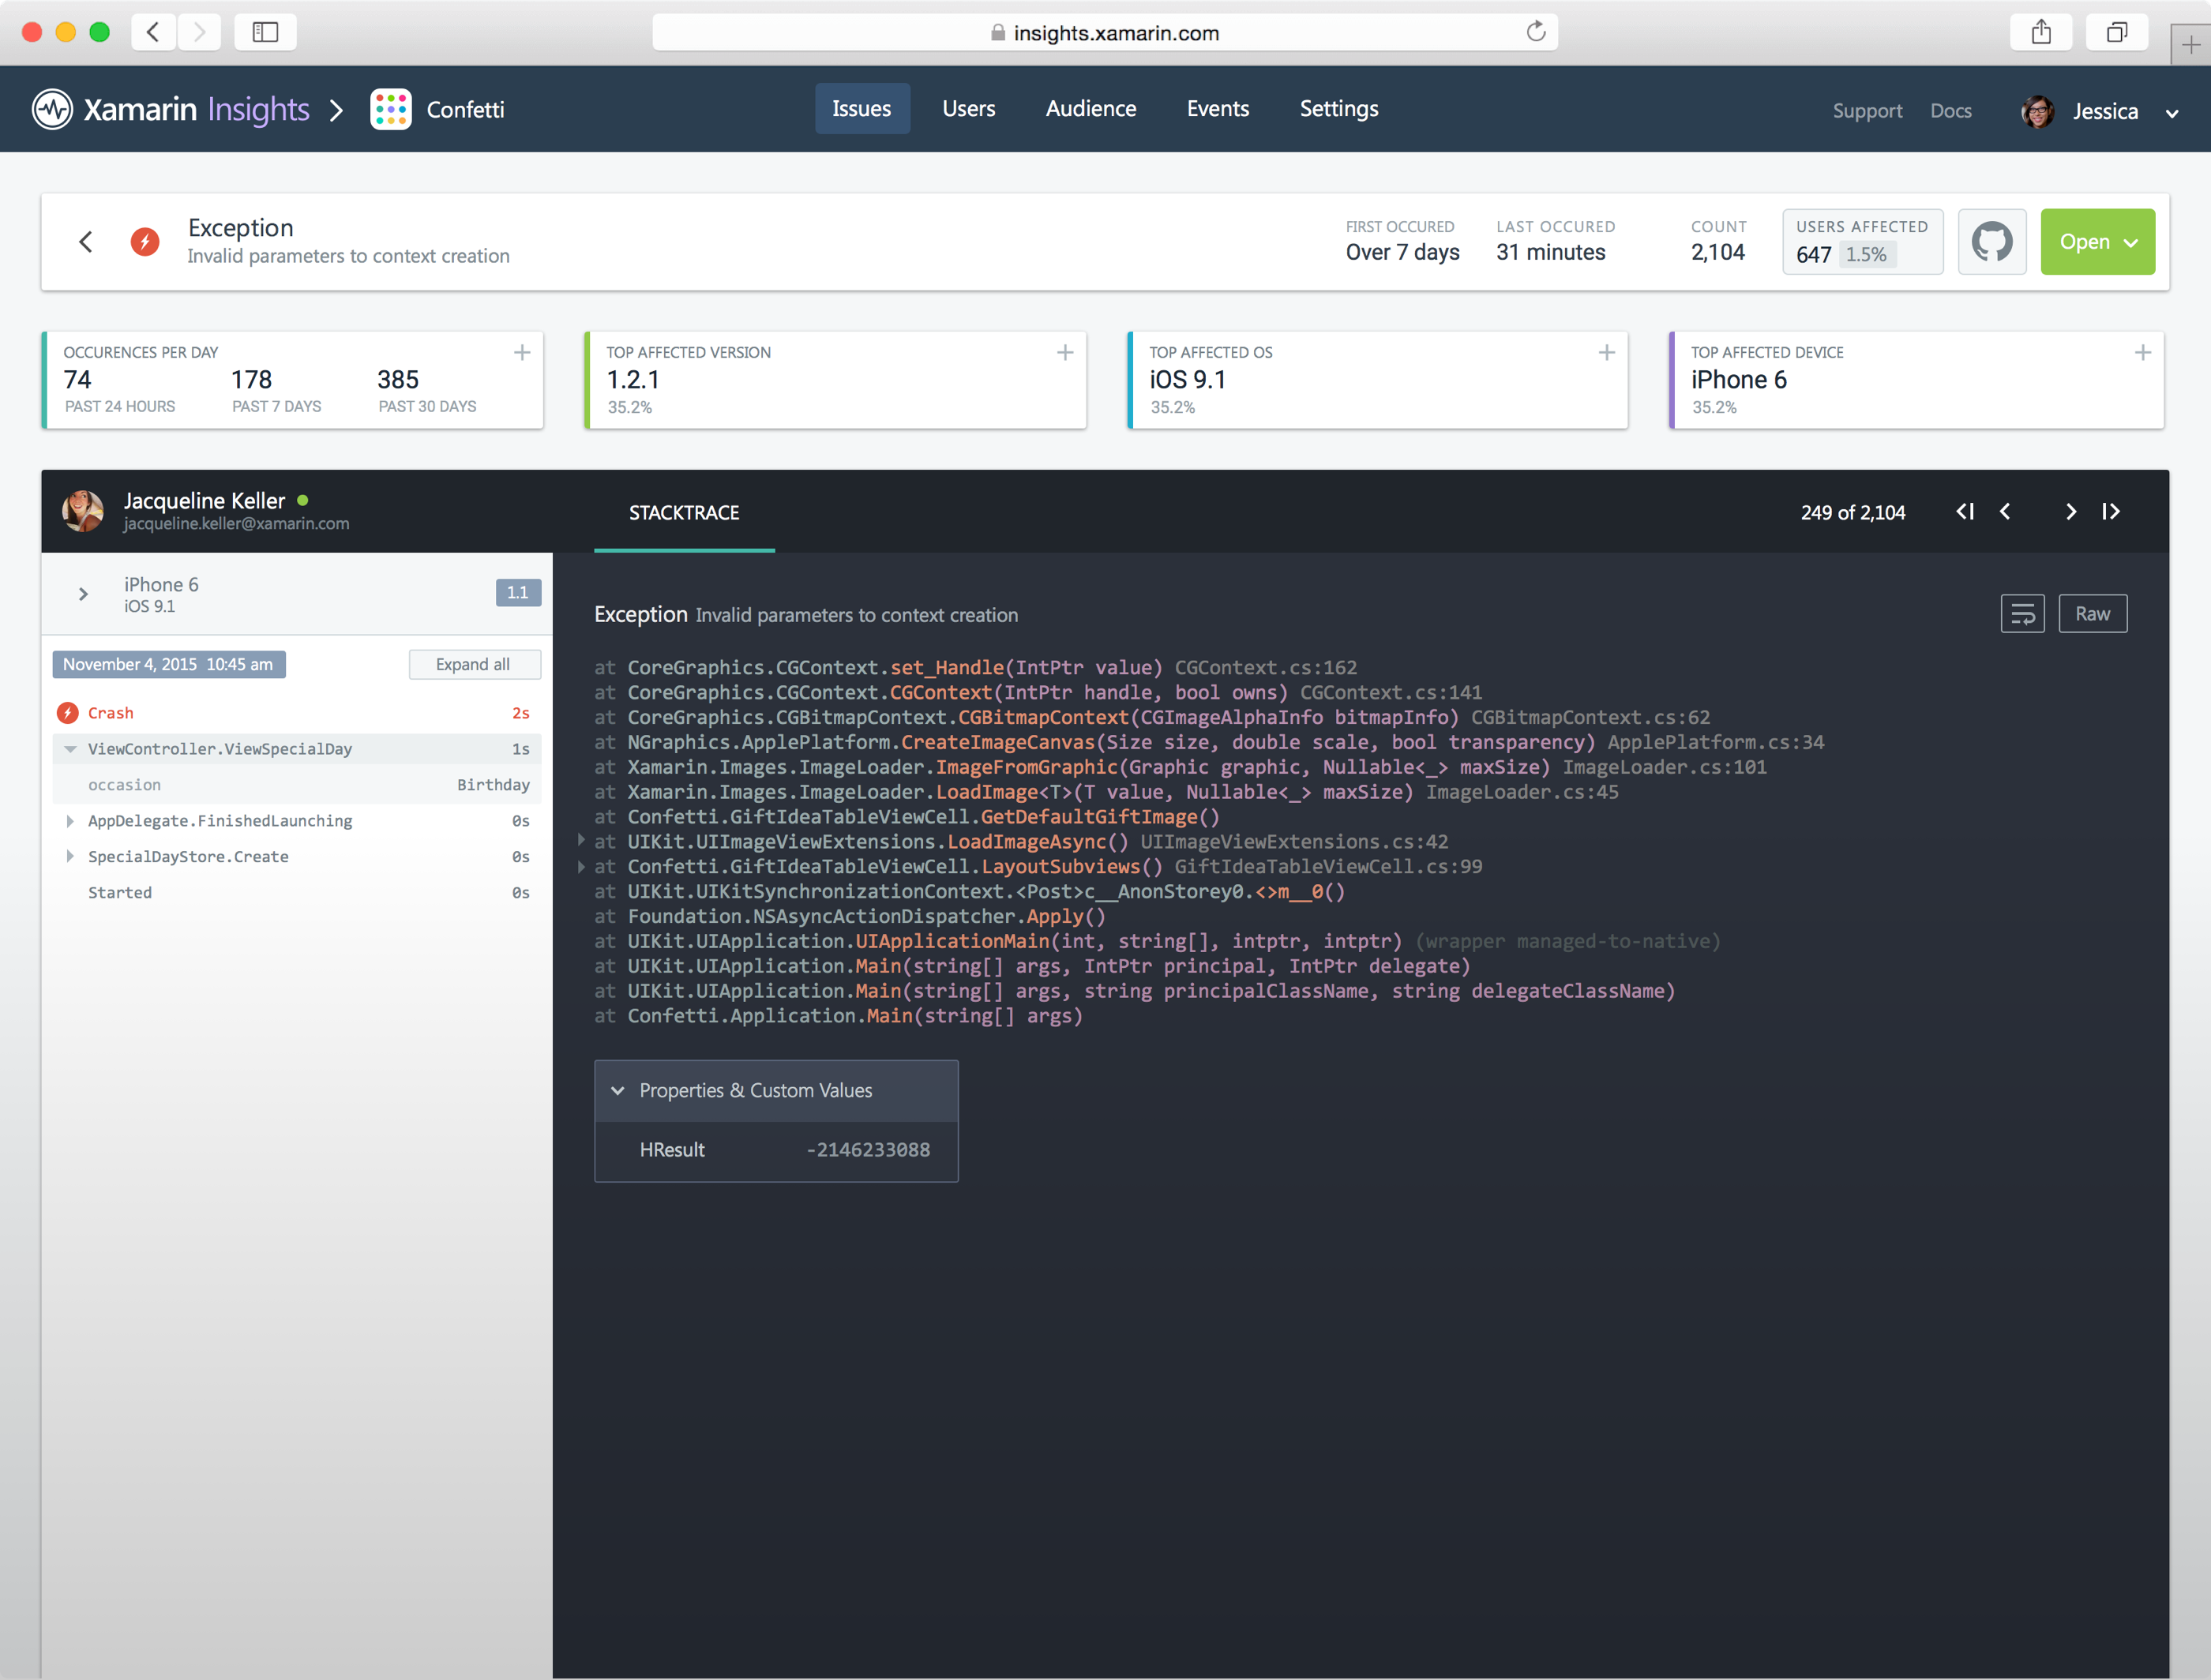
Introducing Xamarin Insights
//Crash Report
Insights.Report(exception);
//Feature Usage
Insights.Track(“Splash Page”);
//Timed Events
Insights.TrackTime(“TimeToSync”);
//User Sessions
Insights.Identify(“Steve”, user_traits);

Slide 40
Xamarin – Your Complete Mobile Solution
BUILD
TEST
MONITOR
ACCELERATE
Notes:
Xamarin is your complete mobile solution.
Xamarin Platform is usually what you hear about which is building native iOS, Android, Mac, and Windows Apps all in C#
However Xamarin offers a wide range of products for developers to go mobile including Test Cloud, Insights, and a way to learn all of mobile with University.

Slide 41





What’s Xamarin University?
Over 60 classes
Guest Lectures and office hours
Lightning Lectures: Bite size learning on specific topics
Certification: Be recognised
for being a
Mobile and
Xamarin expert
Reduced renewal pricing

Slide 42
Xamarin – Your Complete Mobile Solution
BUILD
TEST
MONITOR
ACCELERATE
Notes:
Xamarin is your complete mobile solution.
Xamarin Platform is usually what you hear about which is building native iOS, Android, Mac, and Windows Apps all in C#
However Xamarin offers a wide range of products for developers to go mobile including Test Cloud, Insights, and a way to learn all of mobile with University.

Slide 43
Every Xamarin Platform Subscription Includes:
Unlimited Crash Reporting from Xamarin Insights
With 30 day data retention & detailed issue reports
60 Xamarin Test Cloud Device Minutes per Month
Complete Access to Xamarin.UITest
Including tests of unlimited duration running on simulator or local device
30-day trial pass to Xamarin University
Including access to guest lectures & introductory courses

Slide 44
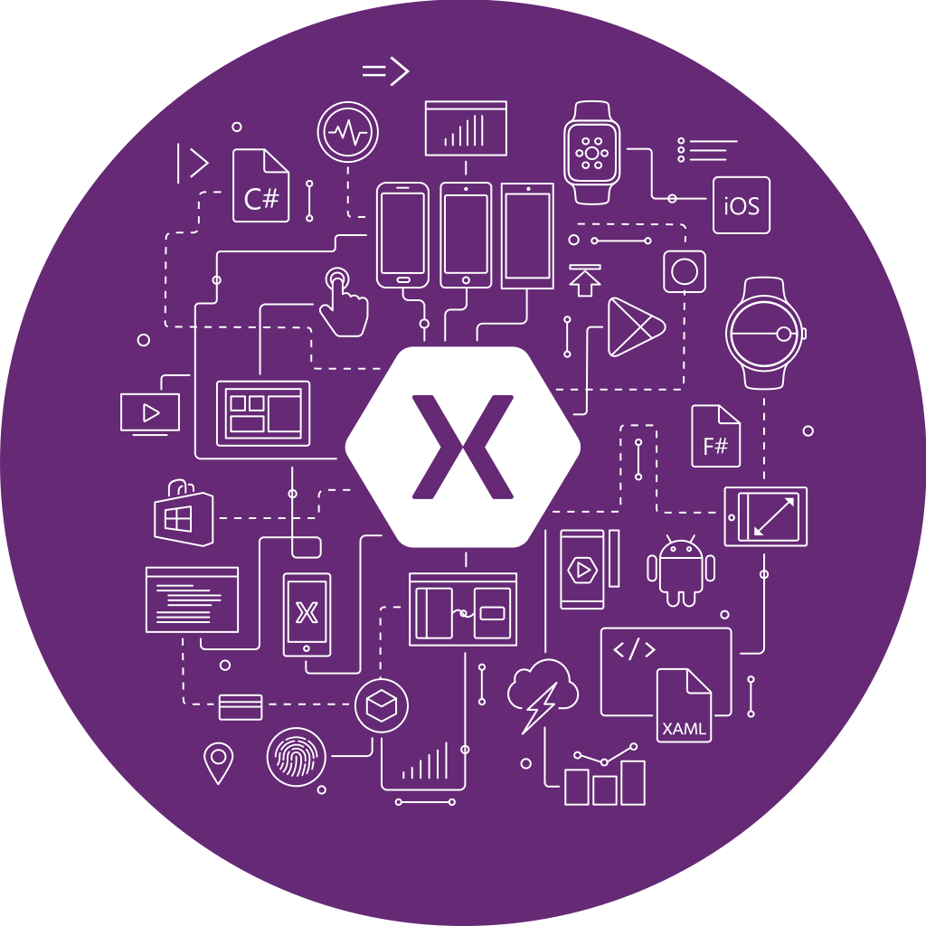
Get Started Today
xamarin.com
Notes:
Get started today with free 30 day trial of Xamarin at xamarin.com

Slide 45

Unrivaled Mobile Development Training
Live unlimited mobile development training from mobile experts, in your time-zone, on your schedule, and as often as you'd like.
Free 30 Day Trial - xamarin.com/university

Slide 46


evolve.xamarin.com

Slide 47
Thank You! Questions?
Dave Evans
dave@pml.co.uk
davedev.ghost.io
@DaveDev

